Slide 1

COLLEGE OF
ENGINEERING & APPLIED SCIENCE
Graduate School Conference
and
Graduate Fair
March 8, 2019
Frank M. Gerner, PhD
Senior Associate Dean
College of Engineering and Applied Science
Professor of Mechanical Engineering

Slide 2

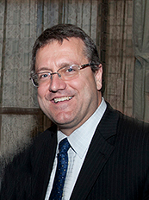
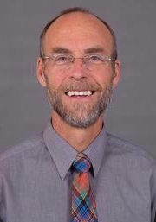

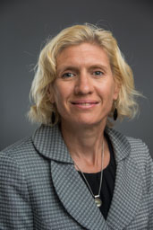
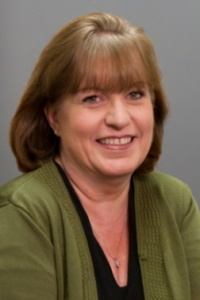
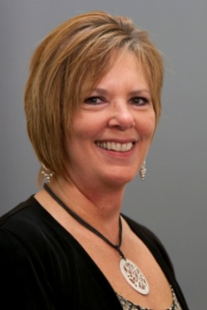

Graduate Studies Office Staff
Dr. Frank M. Gerner
  Sr. Associate Dean for Graduate Studies
  Professor of Mechanical Engineering
  MEng Programs______________________________
  Mr. Eugene Rutz
    Director Academic
    Manager, MEng programs
Ms. Julie Steimle
  Assistant Director
  MEng for all Departments
MS & PhD Programs______________ ______
Ms. Julie Muenchen
  Director Academics – Graduate Studies Office
  Aerospace Eng., Civil Eng., Electrical Eng. and Computing Sciences
Ms. Barb Carter
  Assistant Director
  Biomedical, Chemical, Environmental, Material
  and Mechanical Engineering

Slide 3
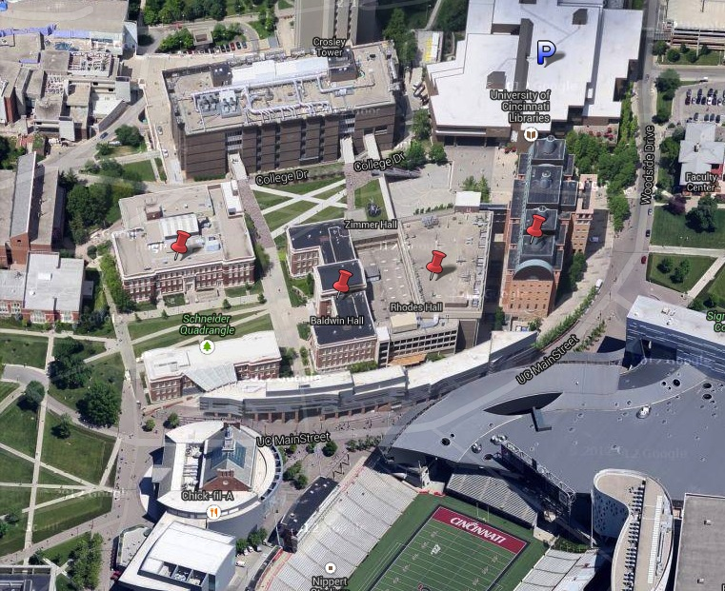

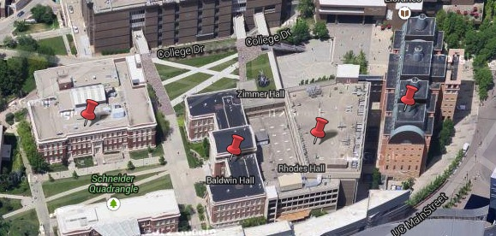


Engineering Facilities
More than 900,000 square feet
Teaching Spaces
Interdisciplinary Laboratories
Research Facilities
at a glance

Slide 4
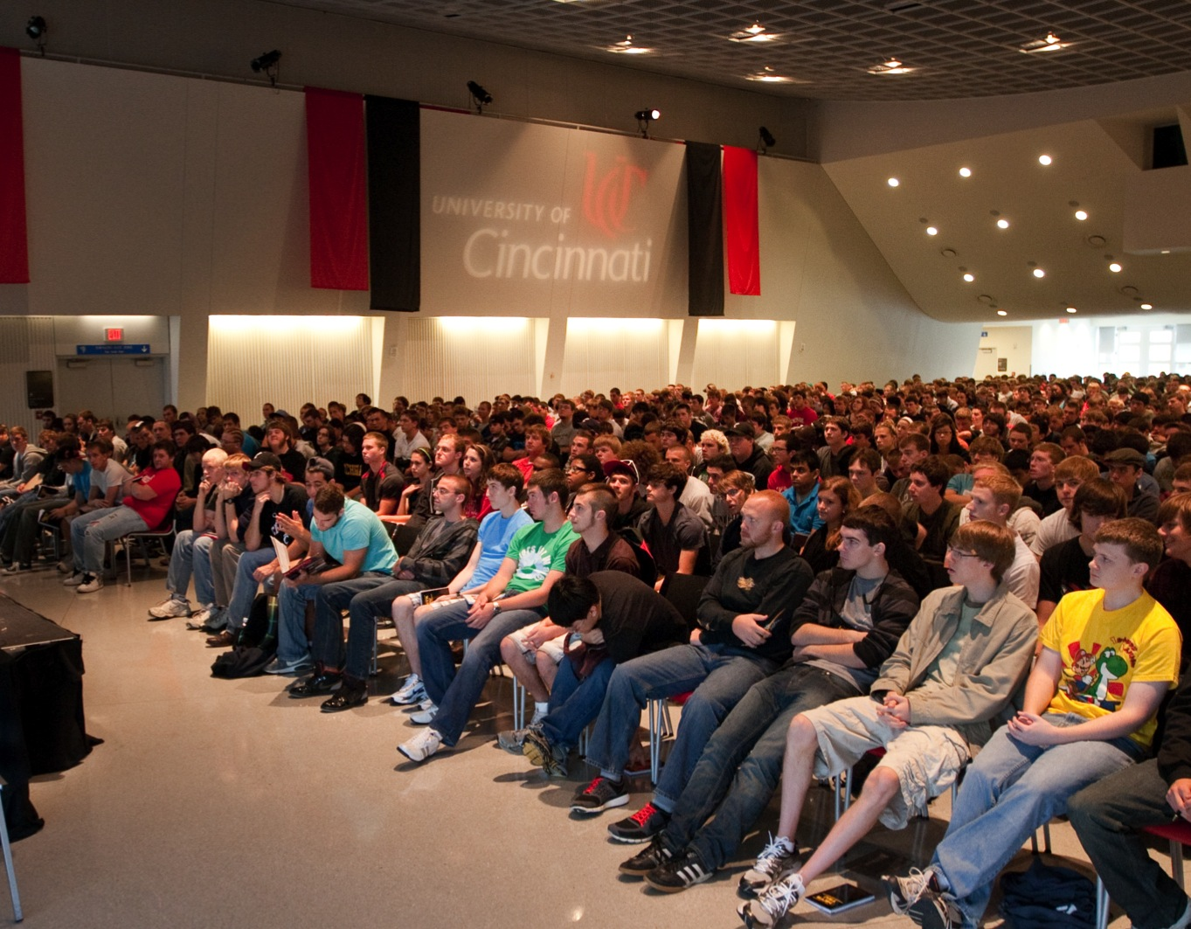
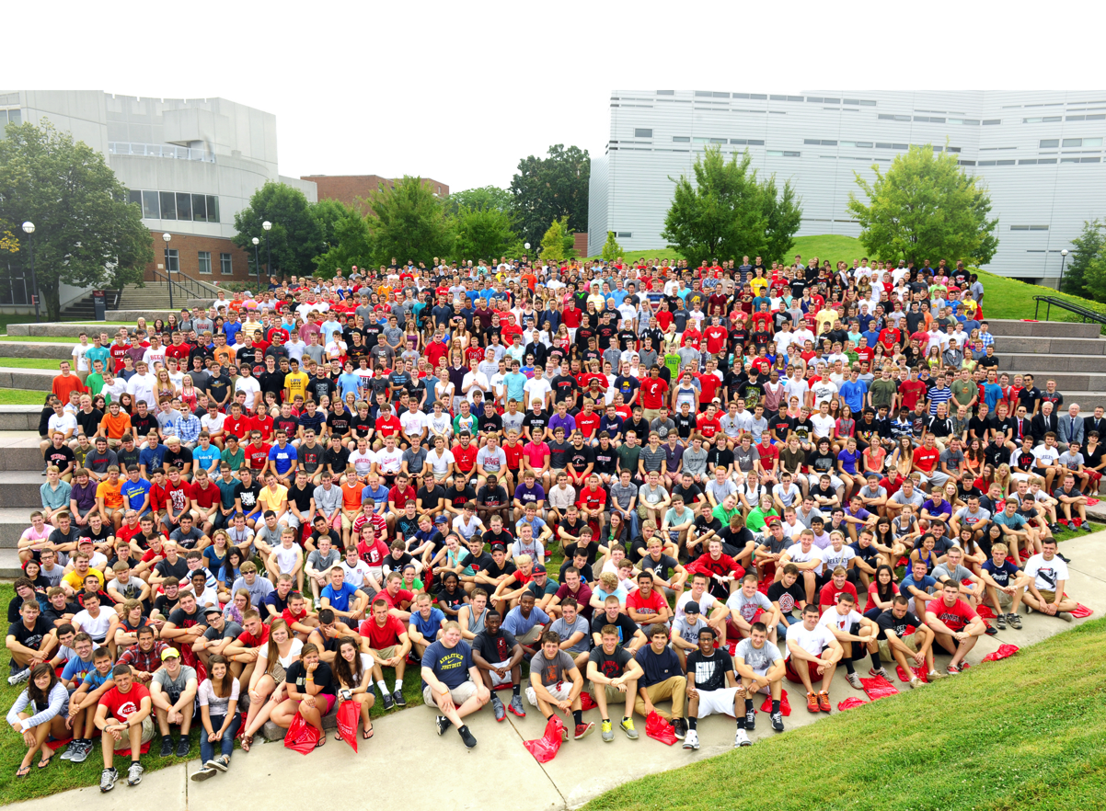
at a glance
~180 faculty members
~4,500 undergraduate students
~1,200 graduate students | 3:2 MS/PhD ratio

Slide 5

DEGREES OFFERED
at a glance
Master of Engineering (MEng)
  Can be completed in one year
  Total 30 credit hours: 24-27 course credit hours plus 3-6 credit hours of capstone
Master of Science (MS)
  Can be completed in 2-3+ years
  Total 30 credit hours: 18-21 course credit hours, 9-12 research credit hours, written thesis
Doctoral (PhD)
  Can be completed in 4-5+ years
  Total 90 credit hours (post-BS): min 30 course credit hours, min 58 thesis research credit hours, written dissertation
  Total 60 credit hours (post-MS): min 18 course credit hours, min 42 research credit hours, written dissertation

Slide 6
Distance Learning
at a glance
Master of Engineering – Online Program
Designed to allow working professionals the opportunity to get a graduate degree
All courses online; students do not need to come to campus
Two courses offered each term; complete the degree in 5 semesters
Same admission requirements and degree requirements as in-person program
Available in Mechanical Engineering and Electrical Engineering

Slide 7

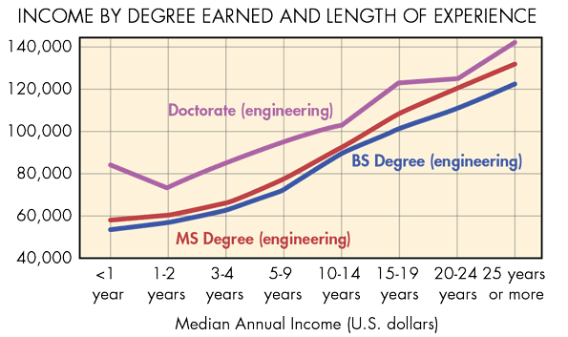

Why Get A Graduate Degree

Slide 8
Program Costs
Full Time Cost Per Academic Semester
 | TOTAL COST ALL -------------------- Tuition/Fees/Health Insurance | Student Out of Pocket Costs --------------------------- After Tuition Scholarship Award | Student Out of Pocket Cost --------------------------- After Tuition Scholarship and GA Tuition scholarship
MS & PhD In-State | $8,970 | $4,259 | $377
MS & PhD Non Resident U.S. | $14,841 | $4259 | $377
MS & PhD Non Resident Intl | $14,966 | $4,384 | $502
MEng In-State | $8,970 | $6,570 | N/A
MEng Non Resident U.S. | $14,841 | $9521 | N/A
MEng Non Resident Intl | $14,966 | $9,646 | N/A

Slide 9
FUNDING Opportunities
Graduate Incentive Scholarship - Every full time student in a MEng, MS or PhD program will qualify for a tuition scholarship.
RA/TA/GA – Research, Teaching and Graduate assistantships are available to some MS and PhD students. This is a stipend of $918.00/bi weekly ($23,868 annually) for 20 hours of work per week. This award will be listed in the offer letter and can be awarded after beginning a degree program from an advisor or the department. RA/TA/GA positions are not guaranteed.
Rindsberg Fellowship – Qualifications for consideration are:
  GPA 3.80+
  BS from an ABET accredited university
  A new incoming US Citizen
  Student has possible interest in pursuing academic career

Slide 10
Application Process
The first step towards joining one of our graduate programs is to submit an online application at: http://grad.catalyst.uc.edu/apply
Application deadline for fall 2019 is May 1, 2019
Required application materials:
  One letters of recommendation
  Unofficial transcripts (undergraduate and graduate)
  Statement of Purpose
  GRE is not required for any student that receives their BS degree from an ABET accredited University in the US with a GPA of 3.0+ with the exception of the Biomedical program. GRE is required from all Biomedical applicants.

Slide 11
Important websites…
Online application: http://grad.catalyst.uc.edu/apply
Information about College of Engineering and Applied Science http://www.ceas.uc.edu/Graduate_Studies.html
Information about UC Graduate School: http://grad.uc.edu
Graduate School Handbook:
  https://grad.uc.edu/fac-staff/handbook.html

Slide 12
For more information…
Visit the CEAS table at the Graduate Fair
Handouts available for each program
Questions?
Speak with one of our representatives at the Graduate Fair CEAS table.

